Slide 1
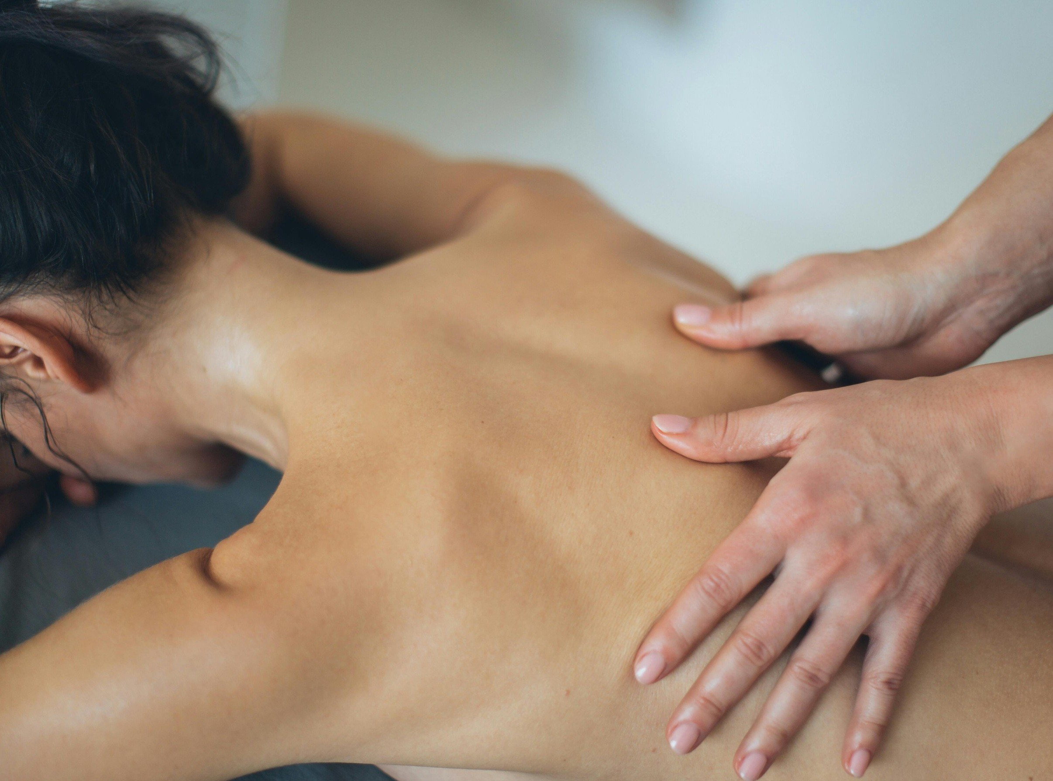
Proposal partnership

Slide 2
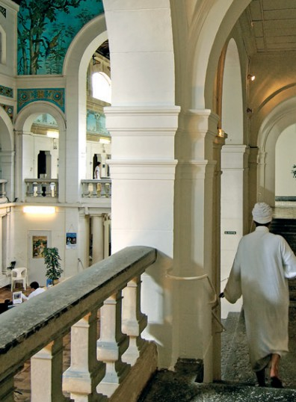
Who are we?
- An association under the French law of 1901, created in 1998 and grouping together 18 Villes d'Eaux du Massif Central, spread over 5 regions and 9 départements.
- A structure for the development and promotion of these Villes d'Eaux, notably through the creation of tourism products and their referral by tour operators and travel agencies.
- An interface between the travel industry and local service providers in the resorts, with a view to fostering contacts (with no additional commission on our part).

Slide 3
What can we bring you?
A customer-focused production method, which, in 2014, resulted in 220 tourism products marketed by 50 tour operators and travel agencies.
Precise, regularly updated knowledge of the Villes d'Eaux, useful for gauging the ability of a particular to meet your specifications.
Communications support for “Route des Villes d'Eaux” products, marketed by tour operators, including our annual ‘Séjours et Week- ends’ brochure, press relations, and our www.villesdeaux.com website (which lists all our products and and highlights our tour operator partners).
The possibility of organizing eductours, financially supported by the Association, to familiarize your sales staff with our products.

Slide 4
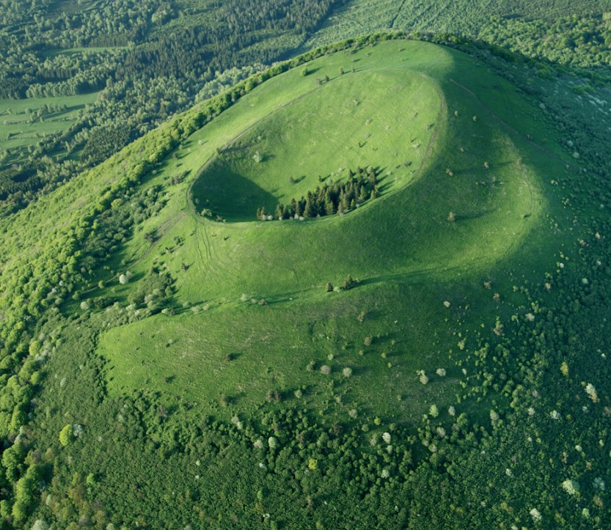
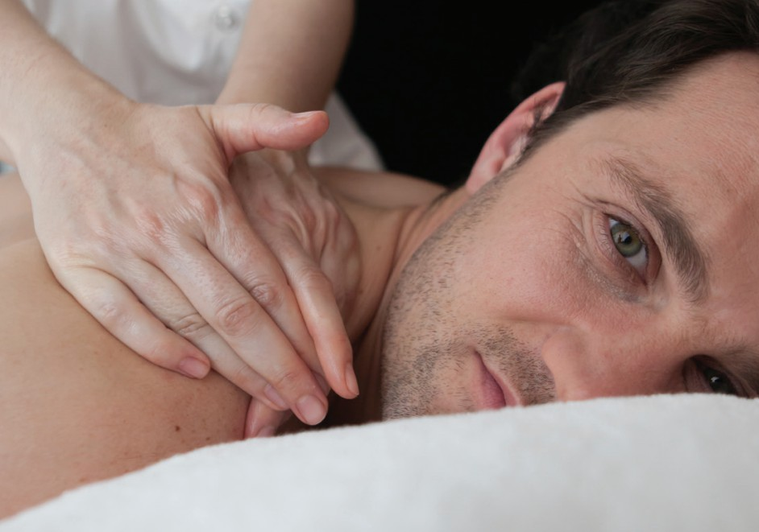
How interesting is our tourism o£ering?
A diversified offering (natural and cultural heritage, sports and leisure facilities, entertainment...) that attracts tourists looking for an authentic, unspoilt destination.
A structured and reliable offering, programmed over several years by major tour operators, that fully satisfies our partners and customers.
A flexible offer that “La Route des Villes d'Eaux du Massif Central” can structure at your convenience to meet your customers' expectations.
A thermal water-based wellness offer in every “Ville d'Eaux”, with a wide range of packages and adapted accommodation that can be linked to the thermal baths.

Slide 5
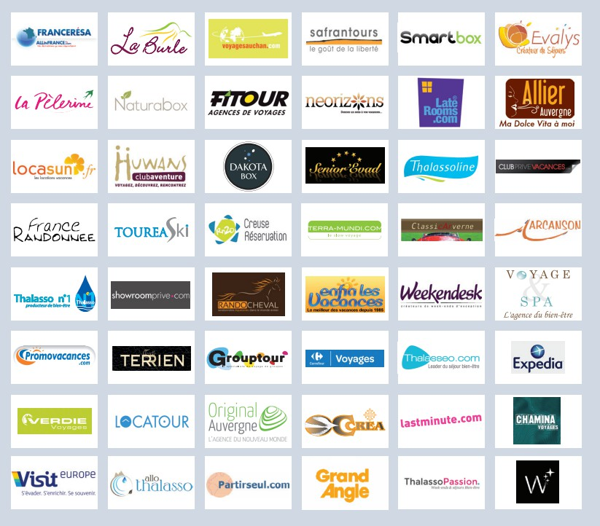
Our current partners

Slide 6
How can you contact us?
If you are interested in our offer and would like to arrange a meeting, please contact Stéphane Huin at “La Route des Villes d'Eaux du Massif Central”.
8 avenue Anatole-France
63130 Royat
s.huin@borvo.com
04 73 34 72 83
04 73 35 74 02
www.villesdeaux.com

